Slide 1

Title: Smart Light System using PIR Sensor and Light Sensor using Arduino Uno
BY - SARANSH PATEL
IBM_PBLP

Slide 2

Objective of the Project
The goal of this project is to automate home lighting using PIR (Passive Infrared) and LDR (Light Dependent Resistor) sensors integrated with an Arduino UNO micro-controller.
Aims to reduce energy consumption by activating lights only when needed.
Integrates motion and ambient light detection for intelligent control.
Showcases a practical application of embedded systems in smart home technology In TinkerCad.

Slide 3

Component List
Arduino UNO: The microcontroller that processes sensor data and controls the relay.
PIR Sensor : Detects motion by sensing changes in infrared radiation.
LDR Sensor : Measures ambient light levels; resistance decreases as light increases.
10kΩ Resistor : Forms a voltage divider with the LDR to measure light intensity.
Relay Module(SPDT) : An electromechanical switch to control the AC bulb safely.
AC Bulb : The light source being controlled.
Power Supply : Provides necessary power to the Arduino and other components.
Breadboard : Used for prototyping and connecting components.
Wires : Connect all components together.

Slide 4
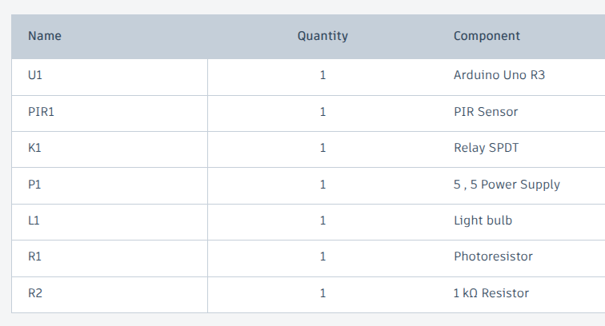

Slide 5
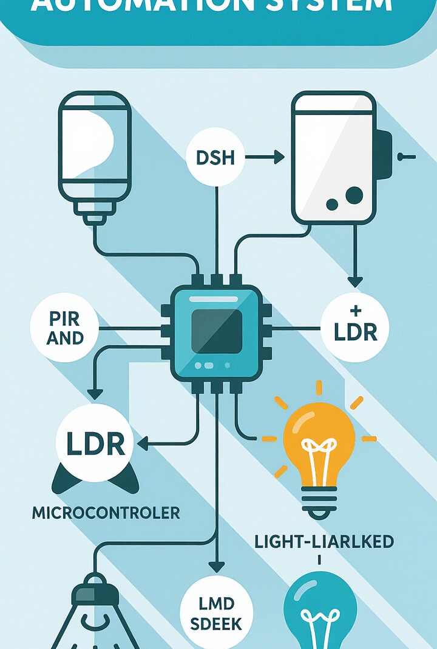
Working Principle
The system activates the AC bulb only when two conditions are met:
Motion Detection : The PIR sensor detects movement within its range.
Low Light : The LDR senses that the ambient light is below a certain threshold. If both conditions are true, the Arduino activates the relay, turning on the bulb.
Energy efficiency is achieved by preventing the bulb from turning on during daylight hours or when no one is present.

Slide 6
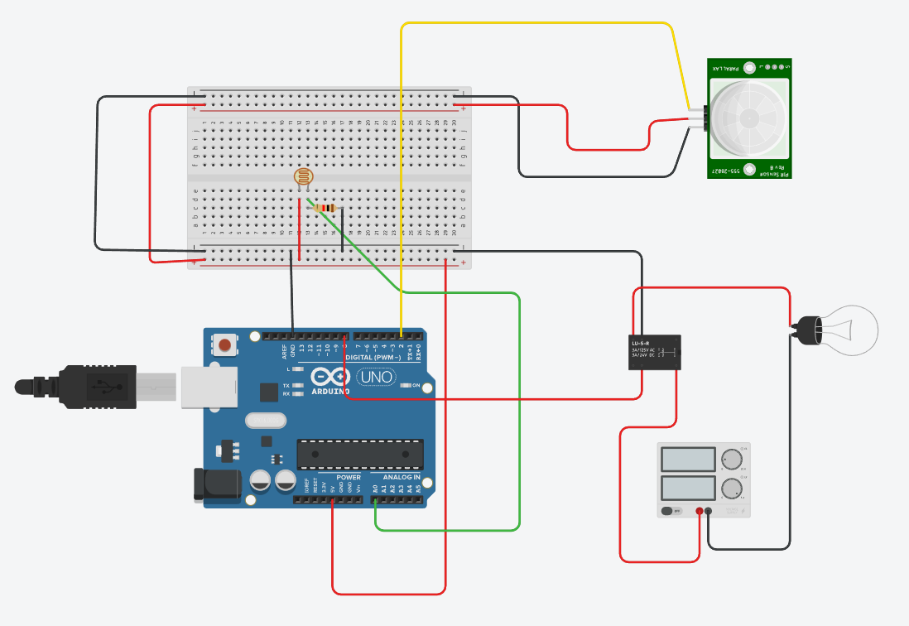
Circuit diagram

Slide 7

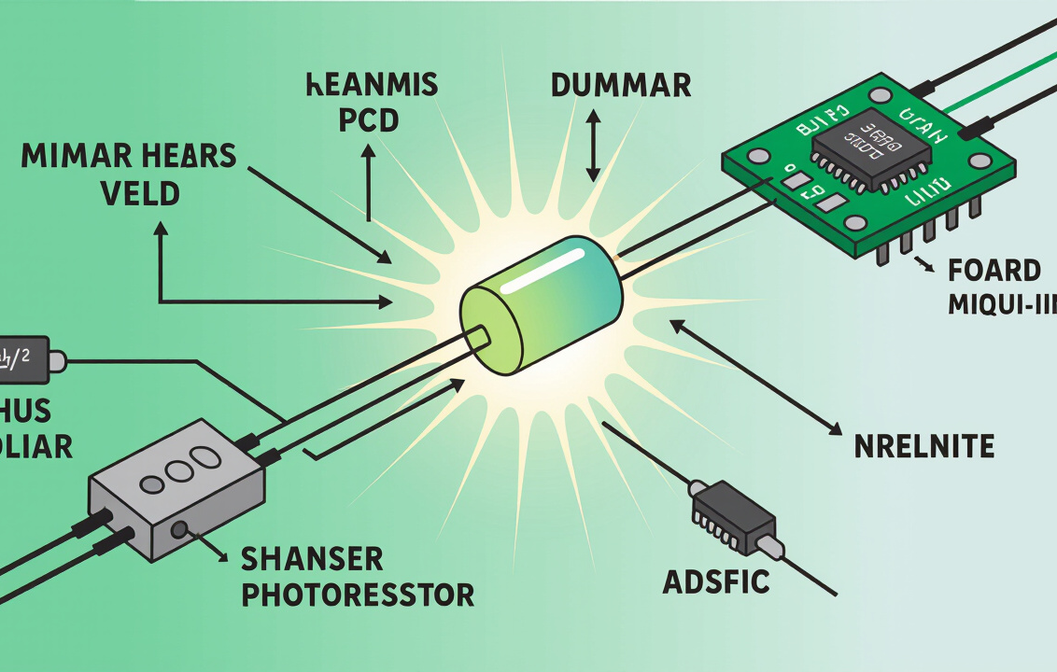
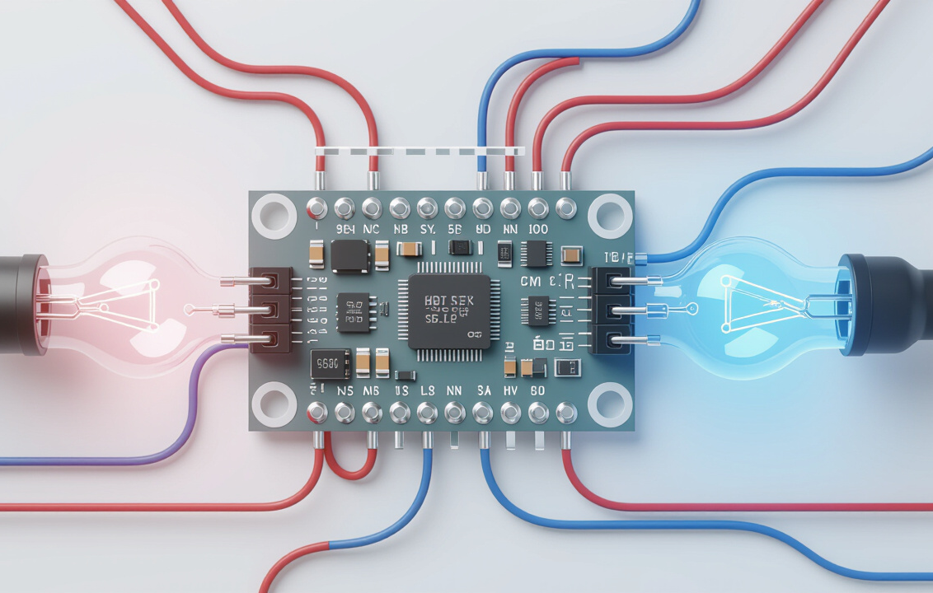
About Sensors and Relay
PIR Sensor
LDR
Relay Module
Detects motion by sensing changes in infrared radiation emitted by warm objects. Outputs a HIGH signal when motion is detected, and LOW otherwise. Adjustable sensitivity and time delay settings.
A photoresistor whose resistance varies based on the intensity of light. Used in a voltage divider circuit to convert light intensity into a voltage that the Arduino can read. Lower resistance in bright light and higher resistance in darkness.
An electromechanical switch that allows a low-voltage circuit (Arduino) to control a high-voltage circuit (AC bulb). Provides electrical isolation between the control circuit and the load circuit. Essential for safely controlling AC devices.

Slide 8
Code snippet
void loop()
{
LightSensorVal = analogRead(A0);
PIRSensorVal = digitalRead(2);
RelayOutputVal = 8;
if (LightSensorVal < 600) {
if (PIRSensorVal == HIGH) {
digitalWrite(8, HIGH);
delay(5000); // Wait for 5000 millisecond(s)
} else {
digitalWrite(8, LOW);
delay(1000); // Wait for 1000 millisecond(s)
}
} else {
digitalWrite(8, LOW);
Serial.println(LightSensorVal);
delay(100); // Wait for 100 millisecond(s)
}
}
// C++ code
int LightSensor = 0;
int LightSensorVal = 0;
int PIRSensorVal = 0;
int RelayOutputVal = 0;
void setup()
{
pinMode(A0, INPUT);
pinMode(2, INPUT);
pinMode(8, OUTPUT);
Serial.begin(9600);
}

Slide 9

Arduino Code Explanation
The Arduino code performs the following main functions:
Sensor Reading: Reads the digital value from the PIR sensor and the analog value from the LDR.
Pin Mode Setup: Configures the digital pins connected to the PIR sensor and relay module as inputs and outputs, respectively.
Conditional Logic: Implements an if statement to check if motion is detected and the light level is low.
Relay Control: Sets the digital output pin connected to the relay module HIGH or LOW to turn the bulb ON or OFF, respectively.

Slide 10

Code Review - Highlights
Motion Detection: Uses digitalRead(PIR_PIN) to check for motion; a HIGH value indicates motion.
Light Sensing: Uses analogRead(LDR_PIN) to read the analog value from the LDR. Higher analog values indicate darker conditions.
Conditional Bulb Activation : The core logic is in the if statement: c++ if (motionDetected && isDark) { digitalWrite(RELAY_PIN, HIGH); // Turn on the bulb } else
Safety and Energy Efficiency: The system ensures the bulb only turns on when needed, reducing energy waste and improving safety by providing light when motion is detected in the dark.

Slide 11
Bulb turns on - Both Condition met
Conditions Met (from code) :
if (LightSensorVal < 600) {
if (PIRSensorVal == HIGH) {
digitalWrite(8, HIGH); // Turn ON bulb
}
}
Explanation:
LightSensorVal < 600: It's dark (night time), no value print on serial monitor .
PIRSensorVal == HIGH: Motion is detected.
Result: Bulb turns ON and remains ON for 5 seconds (delay(5000)).

Slide 12
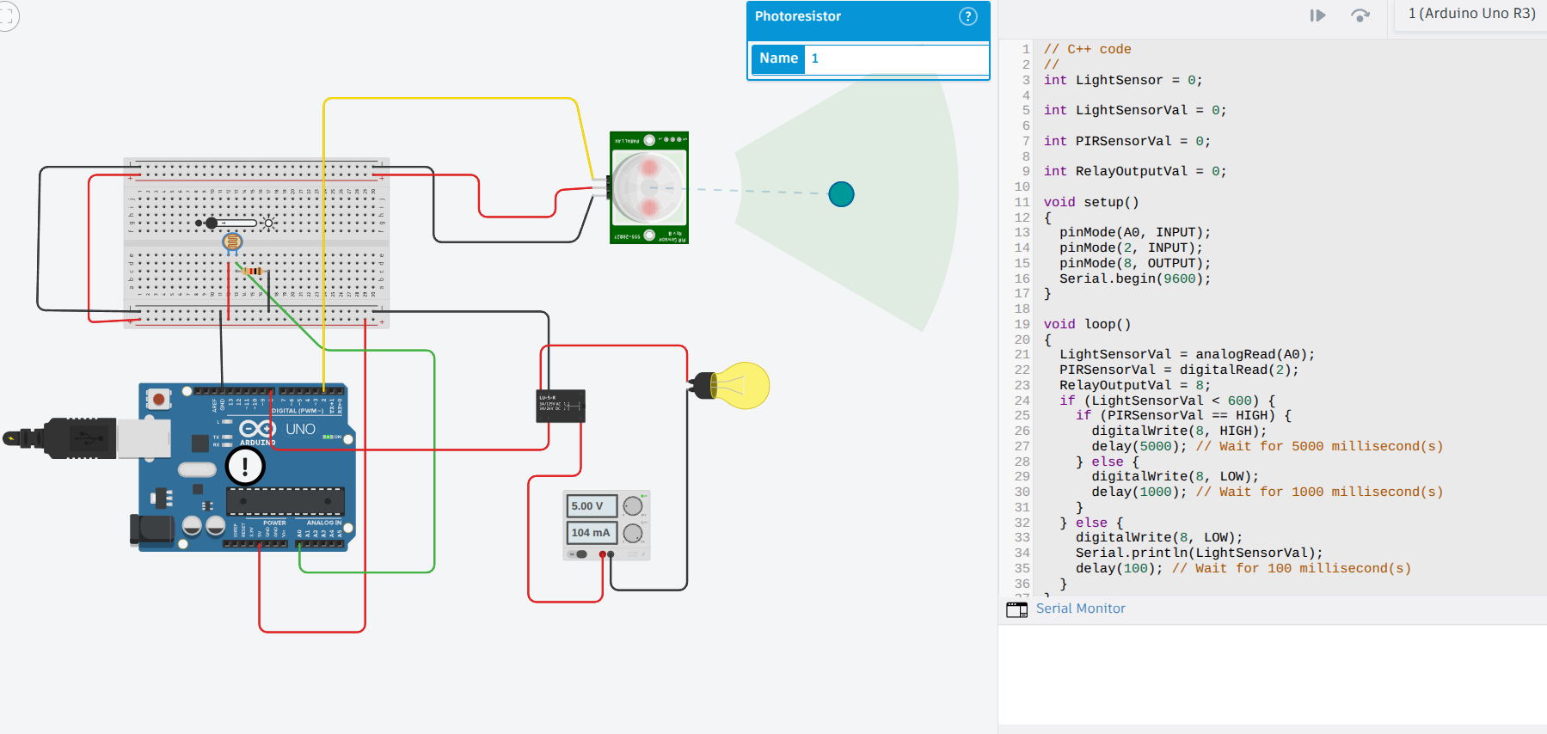

Slide 13
Bulb Remains OFF – Daylight Present
Conditions Triggered (from code):
if (LightSensorVal >= 600) {
digitalWrite(8, LOW); // Keep bulb OFF
}
Explanation:
LightSensorVal >= 600: It's bright (day time), value printed on serial monitor (675 >600) .
Regardless of PIR sensor state, bulb will stay OFF
Result: Even if motion is detected, bulb remains OFF to save energy.

Slide 14


Slide 15
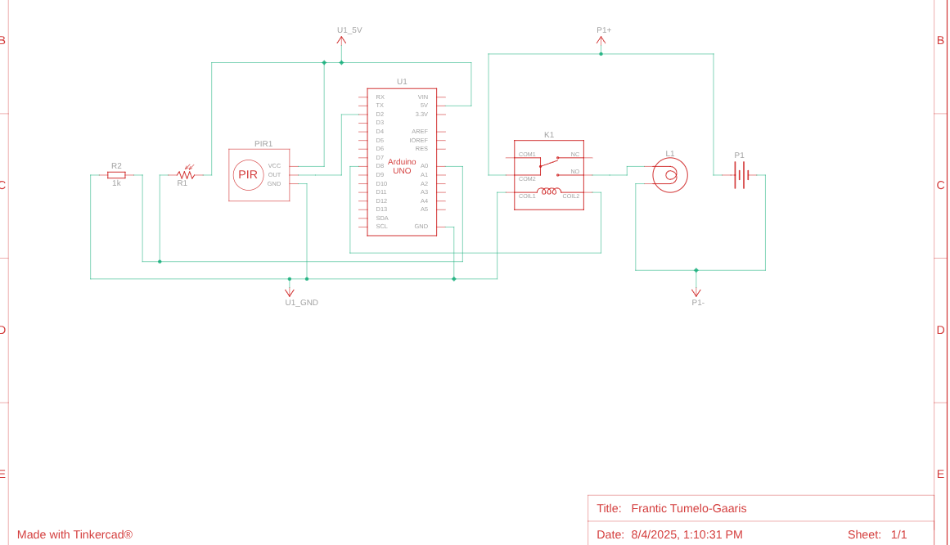
Schematic view

Slide 16

Real-World Applications
Home Lighting Automation: Automatically control indoor and outdoor lights based on occupancy and ambient light.
Office Energy Saving: Reduce electricity bills by ensuring lights are only on when needed in office spaces.
Smart Building Integration: Integrate with building management systems for centralized control and monitoring of lighting.
Security Systems: Use motion-activated lighting as a deterrent for intruders.

Slide 17

Benefits of the System
Energy-Efficient: Reduces energy consumption by only activating lights when necessary.
Cost-Effective: Low component cost and potential savings on electricity bills.
Scalable: Easily expandable to control multiple lights and integrate with other smart home devices.
Improves User Comfort and Safety: Provides convenient and automatic lighting when and where it's needed, enhancing safety.
Demonstrates IoT Principles: Provides a hands-on example of connecting sensors and actuators for automated control.

Slide 18

Conclusion
This project successfully demonstrates the implementation of a smart home lighting system using Arduino, PIR, and LDR sensors.
Provides a practical example of automation principles.
Highlights the potential for energy savings and improved user experience.
Offers a foundation for more advanced smart home applications.
This project illustrates a real-world relevant application of IoT and embedded systems concepts using Arduino.

